Slide 1
Circuits CMSC250

Slide 2

Announcements / Reminders / Schedule
Recording of Sunday’s review session is up.
Homework 4 solutions are also up.
Consult them if you have questions about combinatorial proof structure, or other questions!
Remember:
No hw this week
No quiz this week
But next week there will be both! ☺😐☹
Today & Thursday: circuits!

Slide 3

Announcements / Reminders / Schedule
Expectation of grading:
Homework 4 grading comes first, by Monday.
Midterm grading will take extra time (Friday 03-12).
You will have a full week (through Friday 03-19, Springbreak Friday) to submit regrade requests on Gradescope.
Midterm solutions posted as soon as Thursday 08:01 AM
Probably a bit later, to avoid last – minute panic of any kind.
Logic behind solving will be covered in one of the two discussion sessions next week.

Slide 4
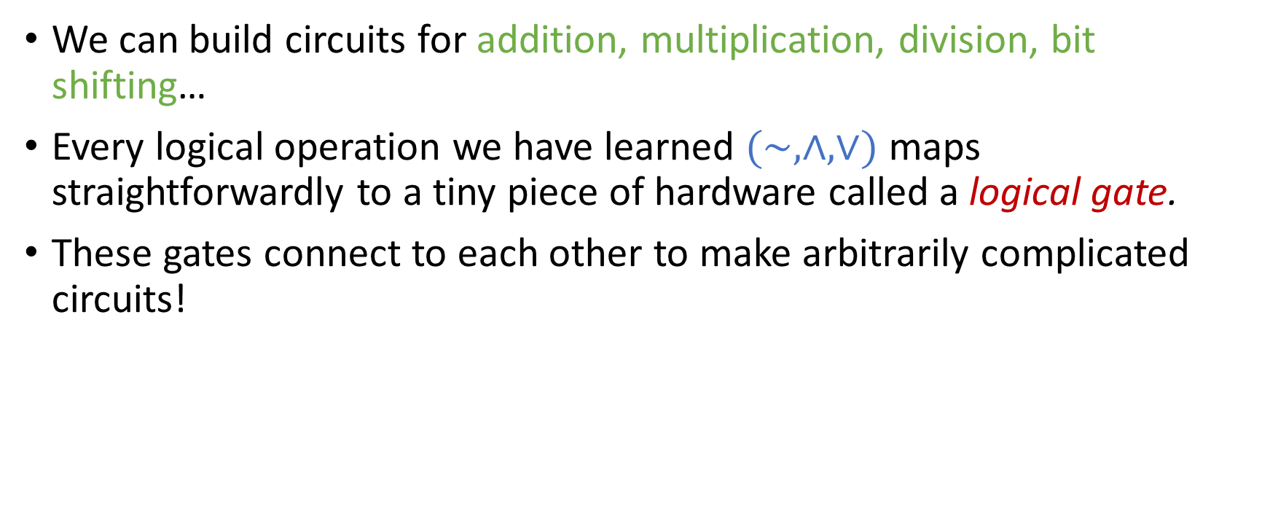
Circuits
We can build circuits for addition, multiplication, division, bit shifting…
Every logical operation we have learned $(\sim ,∧,∨)$ maps straightforwardly to a tiny piece of hardware called a logical gate.
These gates connect to each other to make arbitrarily complicated circuits!

Slide 5
From a truth table to a formula
p | q | r | output
0 | 0 | 0 | 1
0 | 0 | 1 | 0
0 | 1 | 0 | 0
0 | 1 | 1 | 1
1 | 0 | 0 | 1
1 | 0 | 1 | 0
1 | 1 | 0 | 0
1 | 1 | 1 | 1

Slide 6
From a truth table to a formula
p | q | r | output
0 | 0 | 0 | 1
0 | 0 | 1 | 0
0 | 1 | 0 | 0
0 | 1 | 1 | 1
1 | 0 | 0 | 1
1 | 0 | 1 | 0
1 | 1 | 0 | 0
1 | 1 | 1 | 1
Let us focus entirely on the rows that output 1!

Slide 7
Focusing on the 1st row…
p | q | r | output
0 | 0 | 0 | 1
0 | 0 | 1 | 0
0 | 1 | 0 | 0
0 | 1 | 1 | 1
1 | 0 | 0 | 1
1 | 0 | 1 | 0
1 | 1 | 0 | 0
1 | 1 | 1 | 1
p | q | r | output
0 | 0 | 0 | 1
Write a simple formula that is ’1’ only on inputs p =0, q = 0, r = 0.

Slide 8
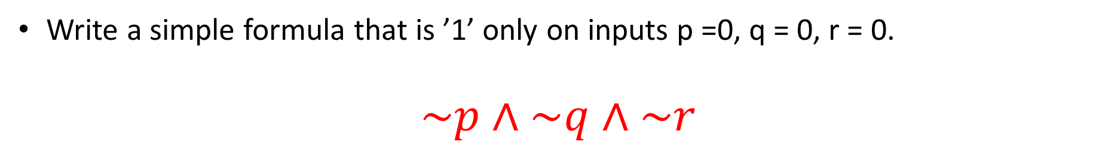
Focusing on the 1st row…
p | q | r | output
0 | 0 | 0 | 1
0 | 0 | 1 | 0
0 | 1 | 0 | 0
0 | 1 | 1 | 1
1 | 0 | 0 | 1
1 | 0 | 1 | 0
1 | 1 | 0 | 0
1 | 1 | 1 | 1
p | q | r | output
0 | 0 | 0 | 1
Write a simple formula that is ’1’ only on inputs p =0, q = 0, r = 0.
$$\sim p∧\sim q∧\sim r$$

Slide 9
Focusing on the 4th row…
p | q | r | output
0 | 0 | 0 | 1
0 | 0 | 1 | 0
0 | 1 | 0 | 0
0 | 1 | 1 | 1
1 | 0 | 0 | 1
1 | 0 | 1 | 0
1 | 1 | 0 | 0
1 | 1 | 1 | 1
p | q | r | output
0 | 1 | 1 | 1
Same deal

Slide 10

Focusing on the 4th row…
p | q | r | output
0 | 0 | 0 | 1
0 | 0 | 1 | 0
0 | 1 | 0 | 0
0 | 1 | 1 | 1
1 | 0 | 0 | 1
1 | 0 | 1 | 0
1 | 1 | 0 | 0
1 | 1 | 1 | 1
p | q | r | output
0 | 1 | 1 | 1
Same deal
$$\sim p∧q∧r$$

Slide 11

Focusing on the 5th row…
p | q | r | output
0 | 0 | 0 | 1
0 | 0 | 1 | 0
0 | 1 | 0 | 0
0 | 1 | 1 | 1
1 | 0 | 0 | 1
1 | 0 | 1 | 0
1 | 1 | 0 | 0
1 | 1 | 1 | 1
p | q | r | output
1 | 0 | 0 | 1
$$p∧\sim q∧\sim r$$

Slide 12

Focusing on the 8th row…
p | q | r | output
0 | 0 | 0 | 1
0 | 0 | 1 | 0
0 | 1 | 0 | 0
0 | 1 | 1 | 1
1 | 0 | 0 | 1
1 | 0 | 1 | 0
1 | 1 | 0 | 0
1 | 1 | 1 | 1
p | q | r | output
1 | 1 | 1 | 1
$$p∧q∧r$$

Slide 13


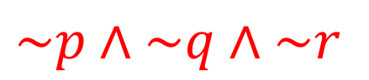

How do we combine those simple formulae?
$$\sim p∧\sim q∧\sim r$$
$$\sim p∧q∧r$$
$$p∧\sim q∧\sim r$$
$$p∧q∧r$$

Slide 14

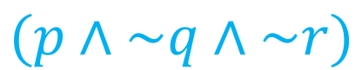



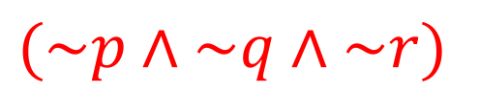

How do we combine those simple formulae?
$$(\sim p∧\sim q∧\sim r)$$
$$∨$$
p | q | r | output
0 | 0 | 0 | 1
0 | 0 | 1 | 0
0 | 1 | 0 | 0
0 | 1 | 1 | 1
1 | 0 | 0 | 1
1 | 0 | 1 | 0
1 | 1 | 0 | 0
1 | 1 | 1 | 1
$$∨$$
$$(\sim p∧q∧r)$$
$$(p∧\sim q∧\sim r)$$
$$∨$$
$$(p∧q∧r)$$
Outputs 1 if and only if the truth table outputs 1!

Slide 15
How do we combine those simple formulae?
$$(\sim p∧\sim q∧\sim r)$$
$$∨$$
p | q | r | output
0 | 0 | 0 | 1
0 | 0 | 1 | 0
0 | 1 | 0 | 0
0 | 1 | 1 | 1
1 | 0 | 0 | 1
1 | 0 | 1 | 0
1 | 1 | 0 | 0
1 | 1 | 1 | 1
$$∨$$
$$(\sim p∧q∧r)$$
$$(p∧\sim q∧\sim r)$$
$$∨$$
$$(p∧q∧r)$$
Outputs 1 if and only if the truth table outputs 1!
We want to do this in hardware!

Slide 16
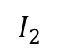
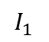
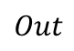
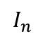
Logical gates
The smallest pieces of hardware that we will examine are called logical gates.
Every gate that we encounter will take bits as inputs and will emit one bit as output.
Those gates can connect to each other in various different ways in order to create more complex circuits
$$I_{1}$$
$$I_{2}$$
Gate
$$Out$$
$$I_{n}$$

Slide 17
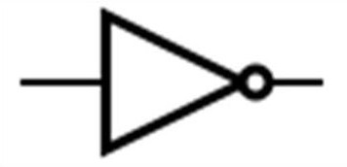
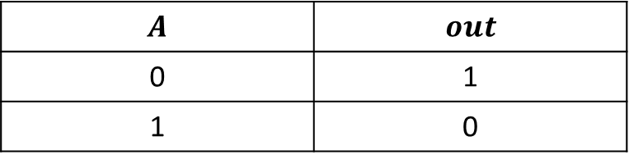
Our first gate
A
out
$$A$$ | $$out$$
0 | 1
1 | 0
This gate is known as the inverter.
It corresponds exactly to the negation operation in propositional logic!
Where 1, set True.
Where 0, set False

Slide 18
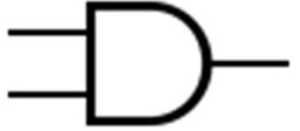
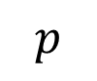
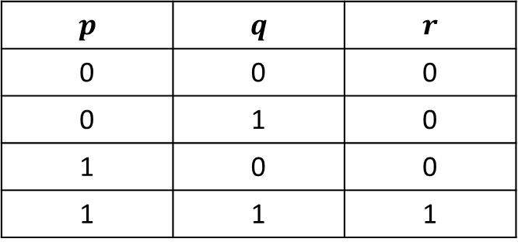
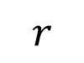
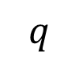
Our second gate
$$p$$ | $$q$$ | $$r$$
0 | 0 | 0
0 | 1 | 0
1 | 0 | 0
1 | 1 | 1
$$p$$
$$r$$
$$q$$
Corresponds to:
Conjunction
Disjunction

Slide 19
Our second gate (AND gate)
$$p$$ | $$q$$ | $$r$$
0 | 0 | 0
0 | 1 | 0
1 | 0 | 0
1 | 1 | 1
$$p$$
$$r$$
$$q$$
Corresponds to:
Conjunction
Disjunction

Slide 20
Our second gate (AND gate)
$$p$$ | $$q$$ | $$r$$
0 | 0 | 0
0 | 1 | 0
1 | 0 | 0
1 | 1 | 1
$$p$$
$$r$$
$$q$$
Corresponds to:
Conjunction
Disjunction

Slide 21
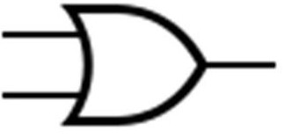
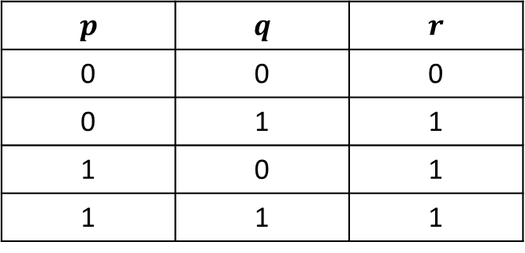
Our third gate (OR gate)
$$p$$ | $$q$$ | $$r$$
0 | 0 | 0
0 | 1 | 1
1 | 0 | 1
1 | 1 | 1
$$p$$
$$r$$
$$q$$
Corresponds to logical disjunction (OR)

Slide 22
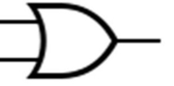
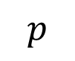
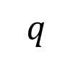
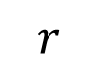
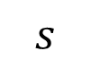
Exercises
Which boolean function does this circuit correspond to?
$$p$$
$$s$$
$$q$$
$$r$$

Slide 23

Exercises
Which boolean function does this circuit correspond to?
$$p$$
$$s$$
$$q$$
$$r$$
$$\left(p∧s\right)∨r$$

Slide 24
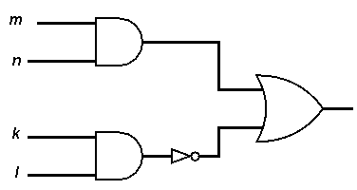
Exercises
And this?

Slide 25
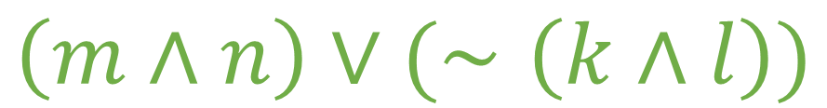
Exercises
And this?
$$\left(m∧n\right)∨(∼\left(k∧l\right))$$

Slide 26
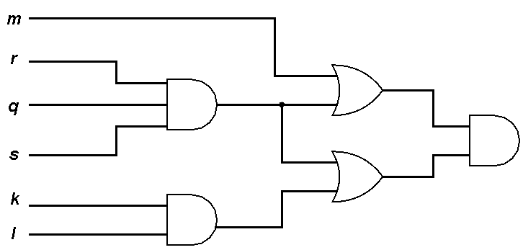
And this?

Slide 27
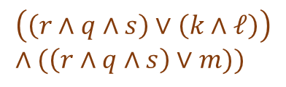
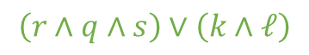
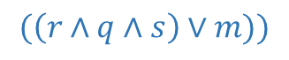
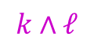
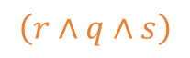
And this?
$$(\left(r∧q∧s\right)∨m))$$
$$\left(r∧q∧s\right)$$
$$\left(\left(r∧q∧s\right)∨\left(k∧ℓ\right)\right) \\ ∧(\left(r∧q∧s\right)∨m))$$
$$\left(r∧q∧s\right)∨\left(k∧ℓ\right)$$
$$k∧ℓ$$
$$(\left(r∧q∧s\right)∨\left(k∧ℓ\right))∧(\left(r∧q∧s\right)∨m))$$

Slide 28

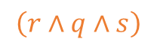
And this?
Can we make this circuit cheaper?
$$(\left(r∧q∧s\right)∨m))$$
$$\left(r∧q∧s\right)$$
$$\left(\left(r∧q∧s\right)∨\left(k∧ℓ\right)\right) \\ ∧(\left(r∧q∧s\right)∨m))$$
$$\left(r∧q∧s\right)∨\left(k∧ℓ\right)$$
$$k∧ℓ$$
$$(\left(r∧q∧s\right)∨\left(k∧ℓ\right))∧(\left(r∧q∧s\right)∨m))$$

Slide 29
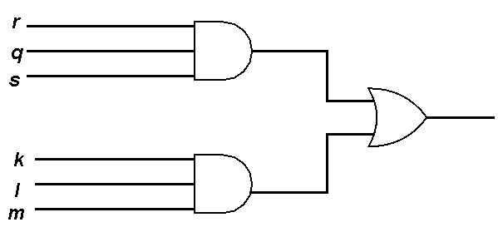
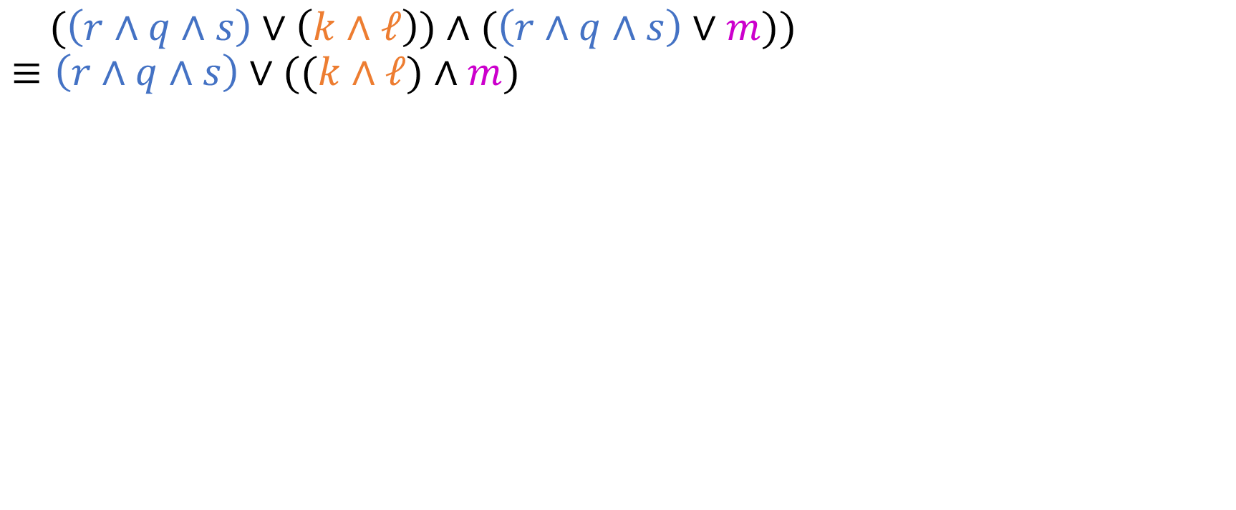
Simplifying the circuit…
$(\left(r∧q∧s\right)∨\left(k∧ℓ\right))∧(\left(r∧q∧s\right)∨m))$ $$≡\left(r∧q∧s\right)∨((k∧ℓ)∧m)$$
New circuit: Three gates
Old circuit: Five gates

Slide 30
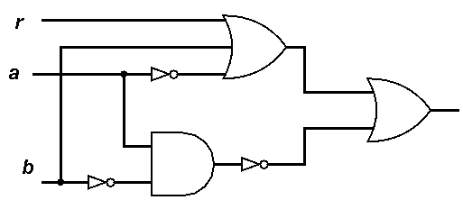
Exercises
Which logical expression is computed by the following circuit?

Slide 31
Exercises
Which logical expression is computed by the following circuit?
Simplify the circuit as much as possible!

Slide 32

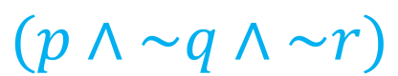




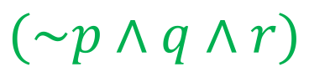
Coming back to our original formula…
$$(\sim p∧\sim q∧\sim r)$$
$$∨$$
$$(\sim p∧q∧r)$$
$$∨$$
$$(p∧\sim q∧\sim r)$$
$$∨$$
$$(p∧q∧r)$$

Slide 33
Coming back to our original formula…
$$(\sim p∧\sim q∧\sim r)$$
$$∨$$
$$(\sim p∧q∧r)$$
$$∨$$
$$(p∧\sim q∧\sim r)$$
$$∨$$
$$(p∧q∧r)$$
For each small formula we have a circuit, and we will combine with a 4-input OR gate!

Slide 34
Coming back to our original formula…
$$(\sim p∧\sim q∧\sim r)$$
$$∨$$
$$(\sim p∧q∧r)$$
$$∨$$
$$(p∧\sim q∧\sim r)$$
$$∨$$
$$(p∧q∧r)$$
For each small formula we have a circuit, and we will combine with a 4-input OR gate!
Circuit 1
Circuit 2
Circuit 3
Circuit 4

Slide 35
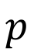
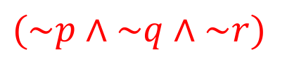
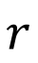
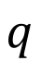
Circuit 1
$$(\sim p∧\sim q∧\sim r)$$
$$p$$
$$q$$
$$r$$

Slide 36

Circuit 2
$$(\sim p∧q∧r)$$
$$p$$
$$q$$
$$r$$

Slide 37

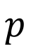
Circuit 3
$$(p∧\sim q∧\sim r)$$
$$p$$
$$q$$
$$r$$

Slide 38

Circuit 4
$$(p∧q∧r)$$
$$p$$
$$q$$
$$r$$

Slide 39
Midterm news / reminders
Panic-free midterm!
We will take an extra day or two to publish solutions
In case somebody has had an emergency / ER / hospital visit / any other emergency.
Monday: you will cover the midterm and have questions from today answered.
Today: Adder circuits!
This concludes the logic portion!
Next week: Set Theory

Slide 40
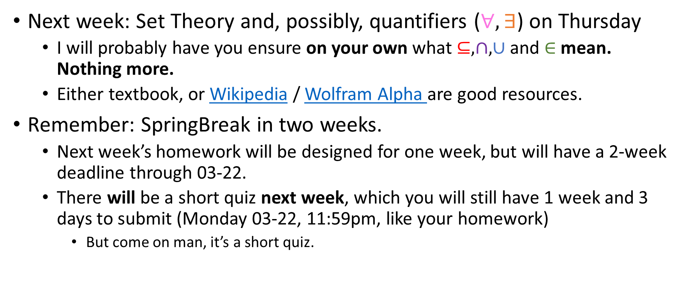
Midterm news / reminders
Next week: Set Theory and, possibly, quantifiers ($∀,∃$) on Thursday
I will probably have you ensure on your own what $⊆, ∩,∪$ and $∈$ mean. Nothing more.
Either textbook, or Wikipedia / Wolfram Alpha are good resources.
Remember: SpringBreak in two weeks.
Next week’s homework will be designed for one week, but will have a 2-week deadline through 03-22.
There will be a short quiz next week, which you will still have 1 week and 3 days to submit (Monday 03-22, 11:59pm, like your homework)
But come on man, it’s a short quiz.

Slide 41
Building Adder Circuits
We want to build circuits that add arbitrarily large binary numbers.
E.g
10011001
+00110011
11001100
Inputs
Output

Slide 42
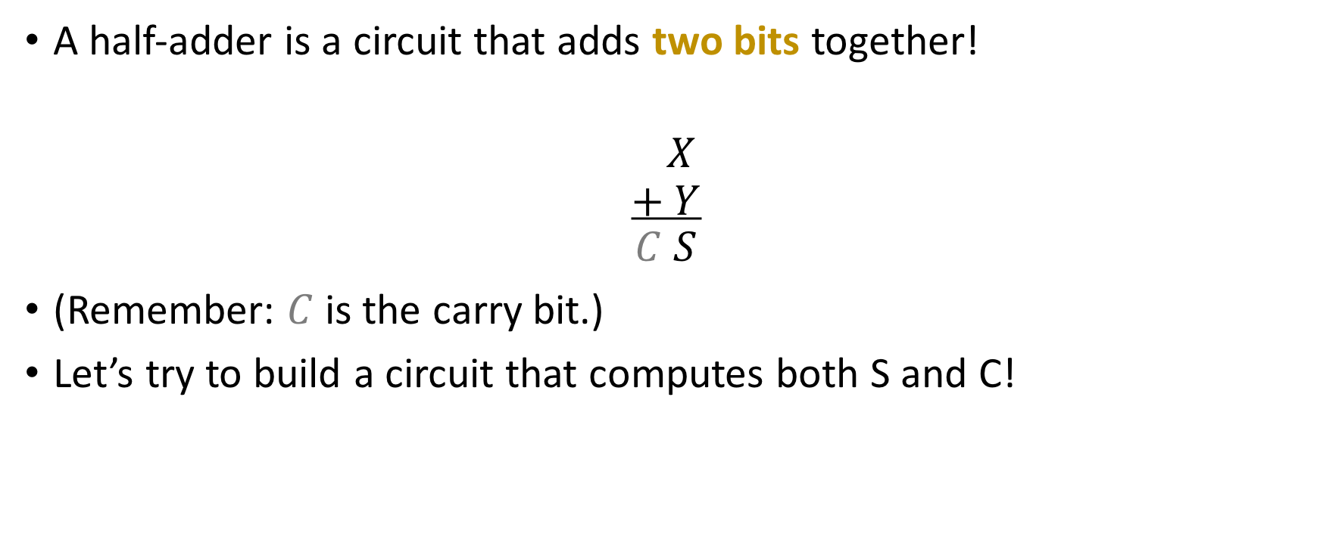
Half-Adder
A half-adder is a circuit that adds two bits together!
$$X \\ + Y \\ C S$$
(Remember: $C$ is the carry bit.)
Let’s try to build a circuit that computes both S and C!

Slide 43
Truth table
X | Y | S | C
0 | 0 | ? | ?
0 | 1 | ? | ?
1 | 0 | ? | ?
1 | 1 | ? | ?

Slide 44
Truth table
X | Y | S | C
0 | 0 | 0 | 0
0 | 1 | 1 | 0
1 | 0 | 1 | 0
1 | 1 | 0 | 1

Slide 45
Truth table
X | Y | S | C
0 | 0 | 0 | 0
0 | 1 | 1 | 0
1 | 0 | 1 | 0
1 | 1 | 0 | 1
X
C
Y
S

Slide 46
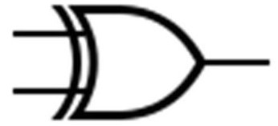
Truth table
X | Y | S | C
0 | 0 | 0 | 0
0 | 1 | 1 | 0
1 | 0 | 1 | 0
1 | 1 | 0 | 1
X
X
S
C
Y
XOR Gate (“Exclusive OR)
Y
S

Slide 47
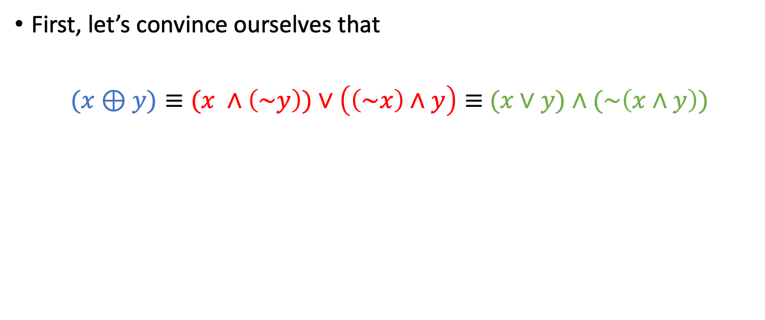
Making XOR cheaper
First, let’s convince ourselves that
$(x⊕y)≡(x ∧\left(\sim y\right))∨\left(\left(\sim x\right)∧y\right)≡$ $(x∨y)∧(\sim \left(x∧y\right))$

Slide 48
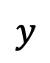
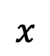



Making XOR cheaper
First, let’s convince ourselves that
$(x⊕y)≡(x ∧\left(\sim y\right))∨\left(\left(\sim x\right)∧y\right)≡(x∨y)∧(\sim \left(x∧y\right))$
$$x$$
$$x$$
$$≡$$
$$y$$
$$≡$$
$$y$$

Slide 49
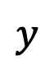
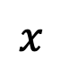
Making XOR cheaper
First, let’s convince ourselves that
$(x⊕y)≡(x ∧\left(\sim y\right))∨\left(\left(\sim x\right)∧y\right)≡(x∨y)∧(\sim \left(x∧y\right))$
$$x$$
$$x$$
$$≡$$
$$y$$
$$y$$

Slide 50




Making XOR cheaper
First, let’s convince ourselves that
$(x⊕y)≡(x ∧\left(\sim y\right))∨\left(\left(\sim x\right)∧y\right)≡(x∨y)∧(\sim \left(x∧y\right))$
From five gates to four!
$$x$$
$$x$$
$$x$$
$$y$$
$$≡$$
$$y$$
$$y$$

Slide 51





Optimizing Half Adder
We can now optimize the Half Adder.
We won’t just use simplified XOR, but also leverage simplified XOR to re-use the AND gate used to compute the carry bit $C$!
$$X$$
$$C=X∧Y$$
$$Y$$
$$S=X ⊕Y≡$$ $(X∨Y)∧(\sim \left(X∧Y\right))$

Slide 52




Half Adder Abstraction
$$X$$
$$C$$
$$Y$$
$$S$$
4 gates, instead of 6 for the previous one!

Slide 53




Half Adder Abstraction
Half-Adder
$$X$$
$$C$$
$$S$$
$$Y$$

Slide 54
Full-Adder
Now, let’s consider the complete case, where we want to build a circuit that computes the sum of two 2-digit binary numbers:
To do this, we also need the ability to add 3 digits, because:
P Q
+ W X
C S1 S2
C1
P Q
+ W X
C S1 S2

Slide 55
Full-Adder
Now, let’s consider the complete case, where we want to build a circuit that computes the sum of two 2-digit binary numbers:
To do this, we also need the ability to add 3 digits, because:
P Q
+ W X
C S1 S2
C1
P Q
+ W X
C S1 S2
We will call a circuit that adds 3 bits a full adder

Slide 56
We could do the truth table….
P Q
+ W X
C S1 S2
P | Q | W | X | C | S₁ | S₂
0 | 0 | 0 | 0
0 | 0 | 0 | 1
0 | 0 | 1 | 0
0 | 0 | 1 | 1
0 | 1 | 0 | 0
0 | 1 | 0 | 1
0 | 1 | 1 | 0
0 | 1 | 1 | 1
1 | 0 | 0 | 0
1 | 0 | 0 | 1
1 | 0 | 1 | 0
1 | 0 | 1 | 1
1 | 1 | 0 | 0
1 | 1 | 0 | 1
1 | 1 | 1 | 0
1 | 1 | 1 | 1

Slide 57
We could do the truth table….
P Q
+ W X
C S1 S2
P | Q | W | X | C | S₁ | S₂
0 | 0 | 0 | 0
0 | 0 | 0 | 1
0 | 0 | 1 | 0
0 | 0 | 1 | 1
0 | 1 | 0 | 0
0 | 1 | 0 | 1
0 | 1 | 1 | 0
0 | 1 | 1 | 1
1 | 0 | 0 | 0
1 | 0 | 0 | 1
1 | 0 | 1 | 0
1 | 0 | 1 | 1
1 | 1 | 0 | 0
1 | 1 | 0 | 1
1 | 1 | 1 | 0
1 | 1 | 1 | 1
But it’s time consuming and we are all busy people

Slide 58




Constructing a Full-Adder in another way
We need to build a circuit that computes the sum of 3 digits, e.g P + Q + R
Step 1: Compute with a half-adder:
P
+ Q
C1S1
Half-Adder
$$P$$
$$C_{1}$$
$$Q$$
$$S_{1}$$

Slide 59











Constructing a Full Adder
Step 2: Compute with another half-adder:
Half-Adder
$$P$$
$$C_{1}$$
$$Q$$
$$S_{1}$$
S1
+ R
C2S
Half-Adder
$$P$$
$$C_{1}$$
$$Q$$
$$S_{1}$$
$$C_{2}$$
Half-Adder
$$R$$
$$S$$

Slide 60









Constructing a full-adder
Half-Adder
$$C_{1}$$
$$P$$
$$C$$
$$Q$$
$$S_{1}$$
$$C_{2}$$
Half-Adder
$$R$$
$$S$$
Step 3: Combine $C_{1}$ and $C_{2}$ with an OR gate to yield the final carry bit $C$.

Slide 61

Constructing a full-adder
Half-Adder
$$C_{1}$$
$$P$$
$$C$$
$$Q$$
$$S_{1}$$
$$C_{2}$$
Half-Adder
$$R$$
$$S$$
Step 3: Combine $C_{1}$ and $C_{2}$ with an OR gate to yield the final carry bit $C$.
Why did we choose an OR gate to combine the “intermediate” carries $C_{1}$ and $C_{2}$?

Slide 62



Constructing a full-adder
Half-Adder
$$C_{1}$$
$$P$$
$$C$$
$$Q$$
$$S_{1}$$
$$C_{2}$$
Half-Adder
$$R$$
$$S$$
Step 3: Combine $C_{1}$ and $C_{2}$ with an OR gate to yield the final carry bit $C$.
Abstraction time!

Slide 63





Full Adder Black Box
3 inputs, 2 outputs
Full Adder
$$P$$
$$S$$
$$Q$$
$$C$$
$$R$$

Slide 64







2-bit adder
However, we still have not solved our original problem, which is to construct a circuit that adds 2-bit numbers!
So, we need a circuit that takes 4 inputs and emits 3 outputs:
P Q
+ W X
C S1 S2
$$Q$$
2-bit adder
$$C$$
$$X$$
$$S_{1}$$
$$P$$
$$S_{2}$$
$$W$$

Slide 65



Constructing a 2-bit adder
Step 1: Take care of the right-most column with a half-adder:
C1
P Q
+ W X
C S1 S2
Half-Adder
$$S_{2}$$
$$Q$$
$$X$$
$$C_{1}$$

Slide 66








Constructing a 2-bit adder
Step 1: Take care of the right-most column with a half-adder:
Step 2 (and final): Connect Half-Adder and new inputs to Full-adder appropriately to produce final circuit.
C1
P Q
+ W X
C S1 S2
$$Q$$
$$S_{2}$$
Half-Adder
$$X$$
$$C_{1}$$
$$P$$
$$S_{1}$$
Full-Adder
$$W$$
$$C$$

Slide 67

Constructing a 2-bit adder
Step 1: Take care of the right-most column with a half-adder:
Step 2 (and final): Connect Half-Adder and new inputs to Full-adder appropriately to produce final circuit.
2-bit adder
C1
P Q
+ W X
C S1 S2
$$Q$$
$$S_{2}$$
Half-Adder
$$X$$
$$C_{1}$$
$$P$$
$$S_{1}$$
Full-Adder
$$W$$
$$C$$

Slide 68








Constructing a 3-bit adder (messy)
C2 C1
A P Q
+ B W X
C3 S₁S₂ S₃
$$Q$$
Half-Adder
$$S_{3}$$
$$X$$
$$C_{1}$$
$$P$$
Full-Adder
$$S_{2}$$
$$W$$
$$C2$$
$$A$$
Full-Adder
$$S_{1}$$
$$B$$
$$C3$$

Slide 69
Constructing a 3-bit adder (neat)
C2 C1
A P Q
+ B W X
C3 S₁S₂ S₃
$$Q$$
2-bit adder
$$S_{3}$$
$$X$$
$$P$$
$$S_{2}$$
$$W$$
$$C2$$
$$A$$
Full-Adder
$$S_{1}$$
$$B$$
$$C3$$

Slide 70





















Constructing an n-bit adder (messy)
$$A_{1}$$
HA
$$S_{1}$$
$$B_{1}$$
$$C_{1}$$
$$A_{2}$$
$$B_{2}$$
FA
$$S_{2}$$
$$C_{2}$$
We have $n−1$ full adders
How many XOR gates do we have?
$$⋮$$
$$⋮$$
$$⋮$$
$$A_{n−1}$$
$$C_{n−2 }$$
FA
$$S_{n−1}$$
$$B_{n−1}$$
$$C_{n−1 }$$
$$A_{n}$$
FA
$$S_{n}$$
$$B_{n}$$
$$C_{n}$$

Slide 71

Constructing an n-bit adder (neat)
$$A_{1}$$
(n-1)-bit adder
$$S_{1}$$
$$B_{1}$$
$$A_{2}$$
$$S_{2}$$
$$B_{2}$$
$$⋮$$
$$⋮$$
$$A_{n−1}$$
$$S_{n−1}$$
$$C_{n−1 }$$
$$B_{n−1}$$
$$A_{n}$$
FA
$$S_{n}$$
$$B_{n}$$
$$C_{n}$$

Slide 72







Fun exercise
Input: number in binary ($B_{0},B_{1})$
Output (in $U_{0},U_{1},U_{2})$: ???
$$B_{1}$$ | $$B_{0}$$ | $$U_{2}$$ | $$U_{1}$$ | $$U_{0}$$
0 | 0 | 0 | 0 | 0
0 | 1 | 0 | 0 | 1
1 | 0 | 0 | 1 | 1
1 | 1 | 1 | 1 | 1
$$U_{2}$$
$$B_{1}$$
Circuit
$$U_{1}$$
$$B_{0}$$
$$U_{0}$$

Slide 73







Fun exercise
Input: number in binary ($B_{0},B_{1})$
Output (in $U_{0},U_{1},U_{2})$: Binary to Unary converter!
$$B_{1}$$ | $$B_{0}$$ | $$U_{2}$$ | $$U_{1}$$ | $$U_{0}$$
0 | 0 | 0 | 0 | 0
0 | 1 | 0 | 0 | 1
1 | 0 | 0 | 1 | 1
1 | 1 | 1 | 1 | 1
$$U_{2}$$
$$B_{1}$$
Circuit
$$U_{1}$$
$$B_{0}$$
$$U_{0}$$

Slide 74





First micro-circuit
$$B_{1}$$ | $$B_{0}$$ | $$U_{2}$$ | $$U_{1}$$ | $$U_{0}$$
0 | 0 | 0 | 0 | 0
0 | 1 | 0 | 0 | 1
1 | 0 | 0 | 1 | 1
1 | 1 | 1 | 1 | 1
$$U_{2}=B_{1}∧B_{0}$$
$$B_{1}$$
$$U_{2}$$
$$B_{0}$$

Slide 75


Second micro-circuit
$$B_{1}$$ | $$B_{0}$$ | $$U_{2}$$ | $$U_{1}$$ | $$U_{0}$$
0 | 0 | 0 | 0 | 0
0 | 1 | 0 | 0 | 1
1 | 0 | 0 | 1 | 1
1 | 1 | 1 | 1 | 1
$$U_{1}={(B}_{1}∧{∼B}_{0})∨(B_{1}∧B_{0})$$

Slide 76



Second micro-circuit
$$B_{1}$$ | $$B_{0}$$ | $$U_{2}$$ | $$U_{1}$$ | $$U_{0}$$
0 | 0 | 0 | 0 | 0
0 | 1 | 0 | 0 | 1
1 | 0 | 0 | 1 | 1
1 | 1 | 1 | 1 | 1
$$U_{1}={(B}_{1}∧{∼B}_{0})∨(B_{1}∧B_{0})=B1$$
(from distributive law of conjunction over disjunction!)
$$B_{1}$$
$$U_{1}$$

Slide 77


Third micro-circuit
$$B_{1}$$ | $$B_{0}$$ | $$U_{2}$$ | $$U_{1}$$ | $$U_{0}$$
0 | 0 | 0 | 0 | 0
0 | 1 | 0 | 0 | 1
1 | 0 | 0 | 1 | 1
1 | 1 | 1 | 1 | 1
$$U_{0}={(∼B}_{1}∧B_{0})∨(B_{1}∧{∼B}_{0})∨(B_{1}∧B_{0})$$

Slide 78



Third micro-circuit
$$B_{1}$$ | $$B_{0}$$ | $$U_{2}$$ | $$U_{1}$$ | $$U_{0}$$
0 | 0 | 0 | 0 | 0
0 | 1 | 0 | 0 | 1
1 | 0 | 0 | 1 | 1
1 | 1 | 1 | 1 | 1
$$U_{0}={(∼B}_{1}∧B_{0})∨(B_{1}∧{∼B}_{0})∨(B_{1}∧B_{0})= {(∼B}_{1}∧B_{0})∨B1={(∼B}_{1} ∨B1)∧{(B}_{0}∨ B1)=B_{0}∨ B1$$
$$B_{1}$$
$$U_{0}$$
$$B_{0}$$

Slide 79






Final circuit
$$B_{1}$$ | $$B_{0}$$ | $$U_{2}$$ | $$U_{1}$$ | $$U_{0}$$
0 | 0 | 0 | 0 | 0
0 | 1 | 0 | 0 | 1
1 | 0 | 0 | 1 | 1
1 | 1 | 1 | 1 | 1
$$U_{0}$$
$$B_{1}$$
$$U_{1}$$
$$B_{0}$$
$$U_{2}$$

Slide 80
Other numeric functions
Addition (have done)
Multiplication
Division
Primality test (test whether a number is prime)
There are circuits for all of these!
Computers actually work this way at the base level: they consist of gates.

